Slide 1
Multiple SEQUANCE ALIGNMENT

Slide 2
CONTENT
Previously on sequence alignment
Multiple sequence alignment algorithms
Evaluation of MSA - Sum of pairs
Multi-dimensional dynamic programming
Progressive algorithm – CLUSTALW
Wrap-up & discussion

Slide 3
PREVIOUSLY ON SEQUENCE ALIGNMENT

Slide 4
PREVIOUSLY ON SEQUENCE ALIGNMENT
3D configuration
>Eif4e
MATVEPETTPTTNPPPAE···
RLISKFDTVEDFWALYNH···
QRRSDLDRFWLETLLCLI···
RVYKERLGLPPKIVIGYQ···
FUNCTION
Similarity in Sequences → Similarity in Structures → Similarity in Functions

Slide 5
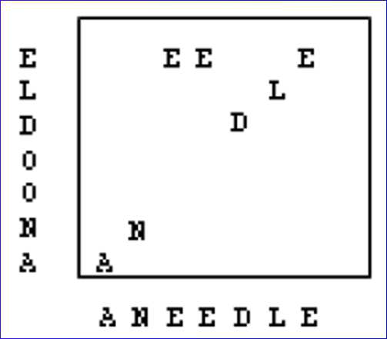
PREVIOUSLY ON SEQUENCE ALIGNMENT
Pairwise alignment methods are used to find the best-matching piecewise (local or global) alignments of two query sequences.
In bioinformatics a dot plot is a graphical method for comparing two biological sequences and identifying regions of close similarity.

Slide 6
PREVIOUSLY ON SEQUENCE ALIGNMENT
 | υ |  | A | T | C | G | T | A | C
ω |  | 0 | 1 | 2 | 3 | 4 | 5 | 6 | 7
 | 0 | 0 | 0 | 0 | 0 | 0 | 0 | 0 | 0
A | 1 | 0 | 1 | 1 | 1 | 1 | 1 | 1 | 1
T | 2 | 0 | 1 | 2 | 2 | 2 | 2 | 2 | 2
G | 3 | 0 | 1 | 2 | 2 | 3 | 3 | 3 | 3
T | 4 | 0 | 1 | 2 | 2 | 3 | 4 | 4 | 4
T | 5 | 0 | 1 | 2 | 2 | 3 | 4 | 4 | 4
A | 6 | 0 | 1 | 2 | 2 | 3 | 4 | 5 | 5
T | 7 | 0 | 1 | 2 | 2 | 3 | 4 | 5 | 5
Dynamic Programming
LCS
……
υ |  | A | T | C | G | T | - | A | - | C
ω |  | A | T | - | G | T | T | A | T | -
υ |  | A | T | C | G | T | - | A | C | -
ω |  | A | T | - | G | T | T | A | - | T

Slide 7
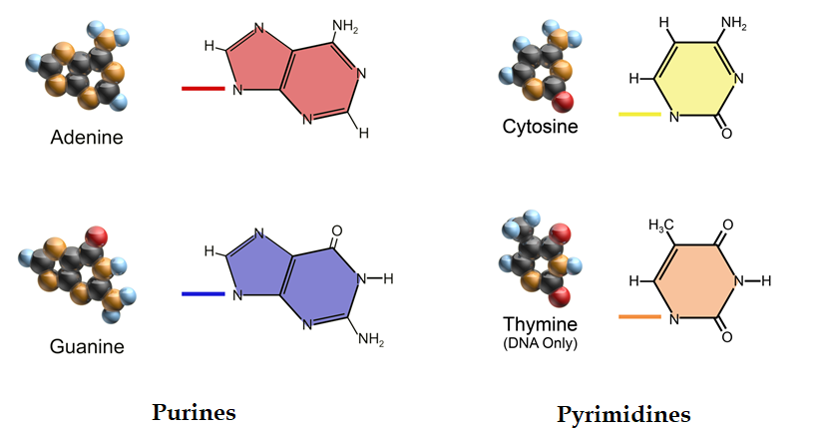
PREVIOUSLY ON SEQUENCE ALIGNMENT
Transition
Transition
Transversion

Slide 8
PREVIOUSLY ON SEQUENCE ALIGNMENT
 | A | T | C | G |  |  | A | T | C | G |  |  | A | T | C | G
A | 1 | 0 | 0 | 0 |  | A | 1 | -5 | -5 | -1 |  | A | 5 | -4 | -4 | -4
T | 0 | 1 | 0 | 0 |  | T | -5 | 1 | -1 | -5 |  | T | -4 | 5 | -4 | -4
C | 0 | 0 | 1 | 0 |  | C | -5 | -1 | 1 | -5 |  | C | -4 | -4 | 5 | -4
G | 0 | 0 | 0 | 1 |  | G | -1 | -5 | -5 | 1 |  | G | -4 | -4 | -4 | 5
Unitary Matrix |  |  |  |  | Transition-Transversion Matrix |  |  |  |  |  |  | BLAST Matrix

Slide 9
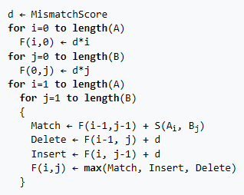
PREVIOUSLY ON SEQUENCE ALIGNMENT
GLOBAL : NEEDLEMAN-WUNSCH ALGORITHM
 | x | G | A | G | C | G
y | 0 | -2 | -4 | -6 | -8 | -10
G | -2 | 1 | -1 | -3 | -5 | -7
G | -4 | -1 | 0 | 0 | -2 | -4
C | -6 | -3 | -2 | -1 | 1 | -1
T | -8 | -5 | -4 | -3 | -1 | 0
match = 1
mismatch = -1
gap penalty = -2
x |  | G | A | G | C | G
 |  | | |  | | | |
y |  | G | - | G | C | T

Slide 10

PREVIOUSLY ON SEQUENCE ALIGNMENT
LOCAL : SMITH-WATERMAN ALGORITHM
 | x | G | A | G | C | G
y | 0 | 0 | 0 | 0 | 0 | 0
G | 0 | 1 | 0 | 1 | 0 | 1
G | 0 | 1 | 0 | 1 | 0 | 1
C | 0 | 0 | 0 | 0 | 2 | 0
T | 0 | 0 | 0 | 0 | 0 | 1
Traceback: start from the highest score & end at 0
match = 1
mismatch = -1
gap penalty = -2
x |  | G | C
 |  | | | |
y |  | G | C

Slide 11
MULTIPLE SEQUENCE ALIGNMENT ALGORITHMS

Slide 12
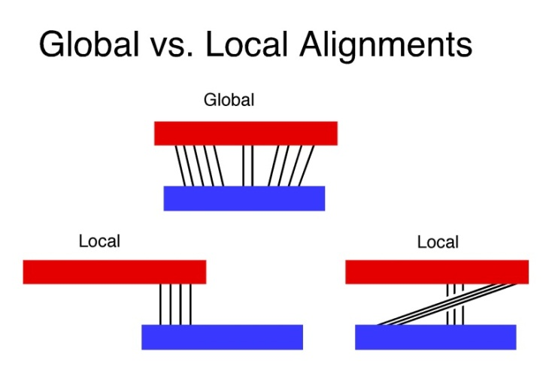
GLOBAL VS LOCAL ALIGNMENTS
Global alignments, which attempt to align every residue in every sequence, are most useful when the sequences in the query set are similar and of roughly equal size. This does not mean global alignments cannot start and/or end in gaps.
Local alignments are more useful for dissimilar sequences that are suspected to contain regions of similarity or similar sequence motifs within their larger sequence context.

Slide 13
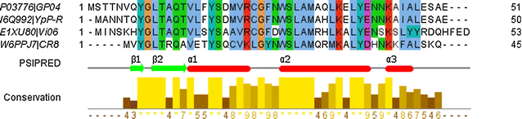
MULTIPLE SEQUENCE ALIGNMENT
Multiple sequence alignment is an extension of pairwise alignment to incorporate more than two sequences at a time. Given k strings, S₁, S₂, ..., S_{k}, a multiple sequence alignment is obtained by inserting gaps in the strings to make them all the same length.

Slide 14
MULTIPLE SEQUENCE ALIGNMENT
Multiple sequence alignment techniques are usually performed to fit one of the following scopes:
To characterize protein families, identify shared regions of homology
Determination of the consensus sequence of several aligned sequences
Help prediction of the secondary and tertiary structures of new sequences
Preliminary step in molecular evolution analysis using phylogenetic methods for constructing phylogenetic trees

Slide 15
MULTIPLE SEQUENCE ALIGNMENT
In summary, multiple sequence alignments are often used in identifying conserved sequence regions across a group of sequences hypothesized to be evolutionarily related. MSA is of use in identification of conserved domains and possibly assignment of function.

Slide 16

FROM PAIRWISE TO MULTIPLE SEQUENCE ALIGNMENT
Do pairwise alignment between all pairs
Combine the pairwise alignments into a single multiple alignment
AAAATTTT
AAAATTTT----
----TTTTGGGG
AAAATTTT----
AAAA----GGGG
AAAATTTT----
----TTTTGGGG
AAAA----GGGG
TTTTGGGG
AAAAGGGG
----TTTTGGGG
AAAA----GGGG

Slide 17


FROM PAIRWISE TO MULTIPLE SEQUENCE ALIGNMENT
AAAATTTT
AAAATTTT----
----TTTTGGGG
AAAATTTT----
AAAA----GGGG
TTTTGGGG
GGGGAAAA
TTTTGGGG----
----GGGGAAAA

Slide 18
MULTIPLE SEQUENCE ALIGNMENT ALGORITHMS
Similarity Measures
Sum of Pairs
Finding Optimal MSAs
Multi-dimensional Dynamic Programming
Heuristics
Progressive Alignment

Slide 19
MULTIPLE SEQUENCE ALIGNMENT ALGORITHMS
Progressive algorithm - ClustalW
Iterative refinement - MUSCLE
Consistency based – T-Coffee, ProbCons
Structured based - Expresso

Slide 20
MULTIPLE SEQUENCE ALIGNMENT ALGORITHMS
Similarity Measures
Sum of Pairs
Finding Optimal MSAs
Multi-dimensional Dynamic Programming
Heuristics
Progressive Alignment

Slide 21
EVALUATION OF MSA - SUM OF PAIRS (SP)
In sequence alignments, an objective function is a numerical quantity for evaluating the quality of the alignments. In mathematical modeling, an optimization problem seeks to maximize or minimize the objective function.
Sum of pairs (SP) - the simplest way to score a MSA.

Slide 22
EVALUATION OF MSA - SUM OF PAIRS (SP)
The sum-of-pairs (SP) score of an multiple sequence alignment is the sum of the scores of all induced pairwise alignments
 | A | C | G | T | -
A | 1 | -1 | -1 | -1 | -1
C | -1 | 1 | -1 | -1 | -1
G | -1 | -1 | 1 | -1 | -1
T | -1 | -1 | -1 | 1 | -1
- | -1 | -1 | -1 | -1 | 0
x |  | A | C | - | G | C | G | G | - | C
y |  | A | C | - | G | C | - | G | A | G
z |  | G | C | C | G | C | - | G | A | G
(A,A) + (A,G) x 2 = -1
(G,G) x 3 = 3
(-,A) x 2 + (A,A) = -1
Total score = (-1) + 3 + (-2) + 3 + 3 + (-2) + 3 + (-1) + (-1) = 5
Substitution matrix

Slide 23
EVALUATION OF MSA - SUM OF PAIRS (SP)
The value of score(-,-) is set equal to 0 which eliminates double counting (or extra penalization) for the use of gaps.
 | A | C | G | T | -
A | 1 | -1 | -1 | -1 | -1
C | -1 | 1 | -1 | -1 | -1
G | -1 | -1 | 1 | -1 | -1
T | -1 | -1 | -1 | 1 | -1
- | -1 | -1 | -1 | -1 | 0
x |  | A | C | - | G | C | G | G | - | C
y |  | A | C | - | G | C | - | G | A | G
z |  | G | C | C | G | C | - | G | A | G
Substitution matrix

Slide 24
MULTIPLE SEQUENCE ALIGNMENT ALGORITHMS
Similarity Measures
Sum of Pairs
Finding Optimal MSAs
Multi-dimensional Dynamic Programming
Heuristics
Progressive Alignment

Slide 25
MULTI-DIMENSIONAL DYNAMIC PROGRAMMING
Generalization of Needleman-wunsch algorithm
Tries to find the longest path in a high-dimensional cube
Uses a N-dimensional matrix
Entry F(i₁, …, i_{k}) represents score of optimal alignment for s₁[1..i₁], … s_{k}[1..i_{k}]
F(i₁,i₂,…,i_{N}) = max_{(all neighbors of a cell)} (F(nbr)+S(current))

Slide 26
MULTI-DIMENSIONAL DYNAMIC PROGRAMMING
Possibility: (2^k – 1) [eg. K=3 -> P=7]
(i-1,j-1,k-1)
(i-1,j,k-1)
F(i,j,k) = Max
F(i-1,j-1,k-1) + S(x_{i}, x_{j}, x_{k})
F(i-1,j-1,k ) + S(x_{i}, x_{j}, -)
F(i-1,j ,k-1) + S(x_{i}, -, x_{k})
F(i ,j-1,k-1) + S(-, x_{j}, x_{k})
F(i-1,j ,k ) + S(x_{i}, -, -)
F(i ,j-1,k ) + S(-, x_{j}, -)
F(i ,j ,k-1) + S(-, -, x_{k})
(i-1,j-1,k)
(i-1,j,k)
(i,j-1,k-1)
(i,j,k-1)
NP-hard (Non-deterministic Polynomial-time hard)
Toooooooo Expensive！
(i,j-1,k)
(i,j,k)

Slide 27
MULTIPLE SEQUENCE ALIGNMENT ALGORITHMS
Similarity Measures
Sum of Pairs
Finding Optimal MSAs
Multi-dimensional Dynamic Programming
Heuristics
Progressive Alignment

Slide 28
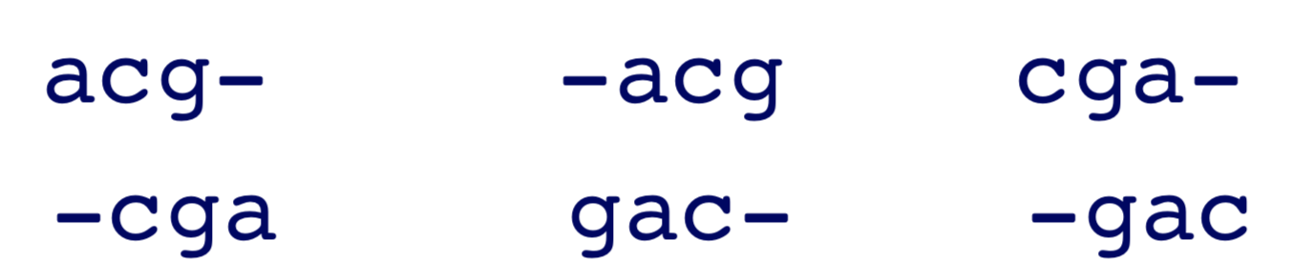
HEURISTICS (经验法则)- PROGRESSIVE ALGORITHM
A heuristic method is used to rapidly come to a solution that is hoped be close to the optimal solution. A heuristic is a “rule of thumb”, an educated guess, an intuitive judgment or simply common sense.
Basic idea - Compute pairwise alignments and merge alignments consistently
E.g. Align acg, cga, gac. Get optimal pairwise alignments:

Slide 29
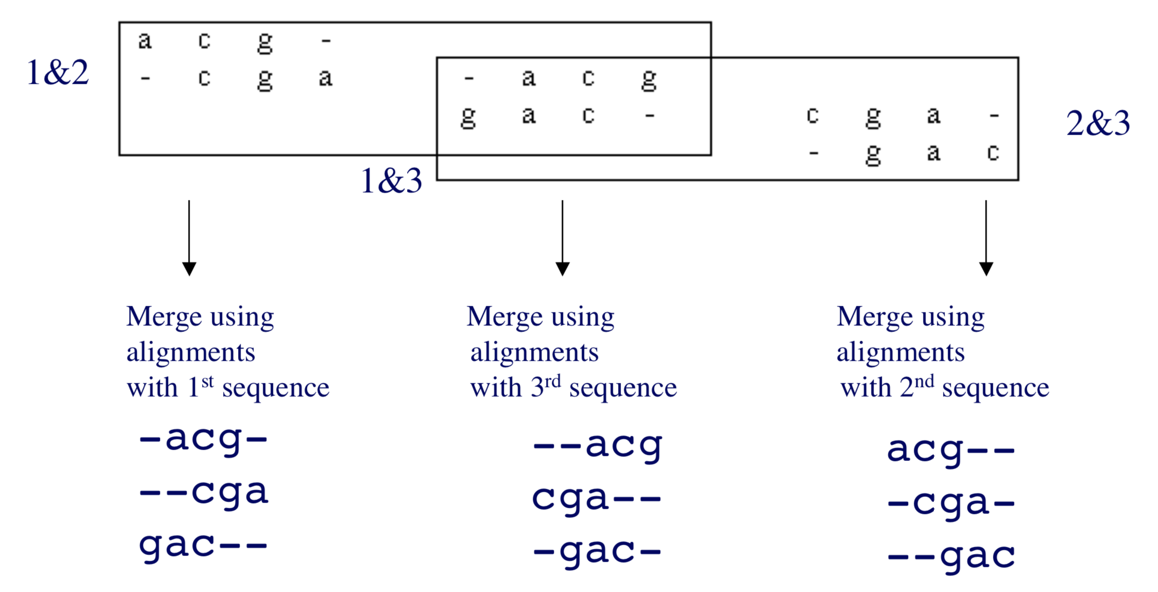
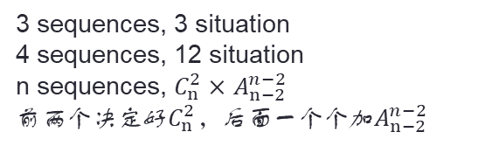
HEURISTICS - PROGRESSIVE ALGORITHM
3 sequences, 3 situation
4 sequences, 12 situation
n sequences, $C_{n}^{2}×$ $A_{n−2}^{n−2}$
前两个决定好$C_{n}^{2}$，后面一个个加$A_{n−2}^{n−2}$
Order of merging matters!

Slide 30
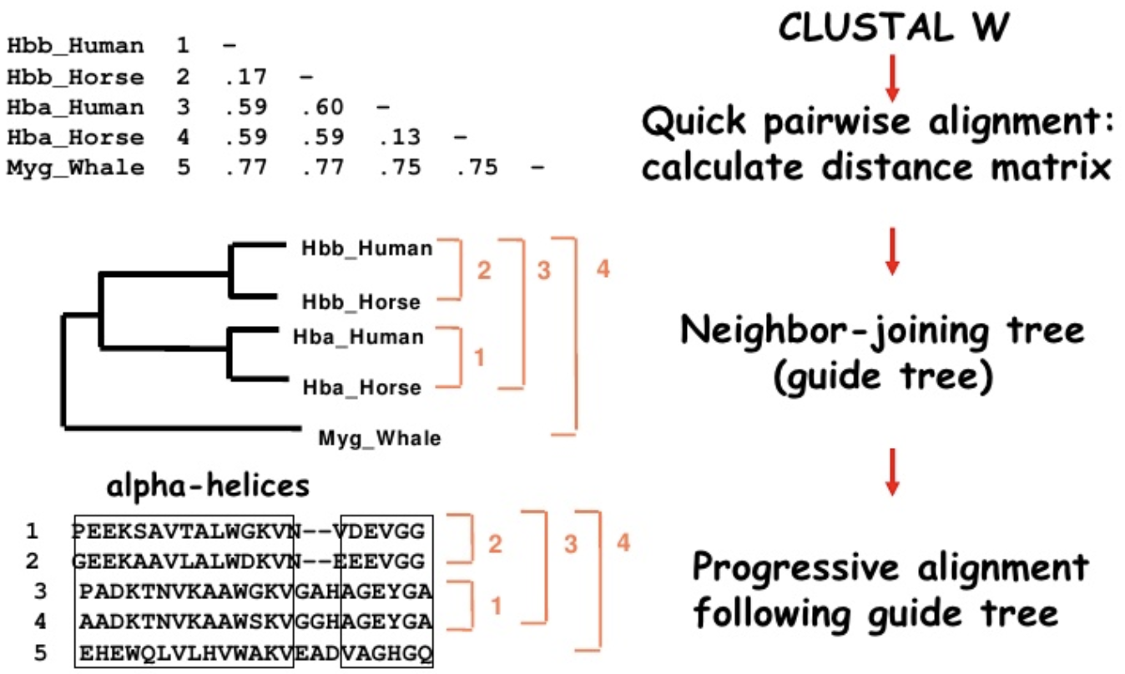
PROGRESSIVE ALGORITHM - CLUSTALW
ClustalW – the most popular multiple sequence alignment tool

Slide 31
PROGRESSIVE ALGORITHM - CLUSTALW
s₁ | GATTCA
s₂ | GTCTGA
s₃ | GATATT
s₄ | GTCAGC
s₁ | GAT-TCA |  |  | s₂ | G-TCTGA
s₂ | G-TCTGA | (score = 1) |  | s₃ | GATAT-T | (score = -1)
s₁ | GAT-TCA |  |  | s₂ | GTCTGA
s₃ | GATAT-T | (score = 1) |  | s₄ | GTCAGC | (score = 2)
s₁ | GATTCA-- |  |  | s₃ | GAT-ATT
s₄ | G-T-CAGC | (score = 0) |  | s₄ | G-TCAGC | (score = -1)
match = 1
mismatch = -1
gap = -1

Slide 32
PROGRESSIVE ALGORITHM - CLUSTALW
The alignment became a new 3-sequence alignment.
s₂ and s₄ are closest and consolidated into a profile.
s₁ | GATTCA
s₃ | GATATT
s_{2,4} | GTC^{t}_{a}Gª_{c}
s₂ | GTCTGA |  | s_{2,4} | GTCt/aGa/c
s₄ | GTCAGC

Slide 33
PROGRESSIVE ALGORITHM - CLUSTALW
Quick pairwise alignments for all sequence pairs and calculate the similarity or distance matrix.
Similarity = number of identities / number of residues compared (gap positions are excluded)
In this case, numbers refer to the distance between sequences

Slide 34
PROGRESSIVE ALGORITHM - CLUSTALW
Build the guide tree by neighbor-joining (NJ) method.
Neighbor-joining method?

Slide 35
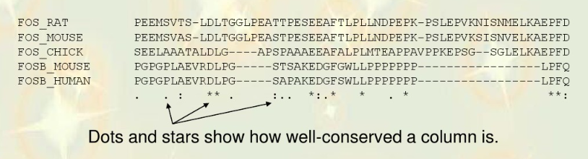
PROGRESSIVE ALGORITHM - CLUSTALW
Progressive alignment following the guide tree.
Align the closest 2 sequences
Add the next closest sequence into the alignment
Repeat till all the sequences are aligned
T and A may chemically similar

Slide 36
WRAP-UP & DISCUSSION

Slide 37
CONTENT
Previously on sequence alignment
Multiple sequence alignment algorithms
Evaluation of MSA - Sum of pairs
Multi-dimensional dynamic programming
Progressive algorithm – CLUSTALW

Slide 38
thanks
 Xin.Liu@xjtlu.edu.cn
 0512-8188 9033, 137 6452 2733
 Science Building Room SA439

